Slide 1
SPACE INVADERS
SERKAN ARDA YILAL 5044

Slide 2
In this project, we made a game like space invaders. There are invaders and our ship in the game. The aim is to defend the our post.
The rules of the game are like that;
No enemy should get back of us, if they do, we are invaded and game is over.
Our ship need to stay alive.
When we kill the boss we win.
Per movement and ammo using decrease our score so we should not move and use ammo so much if we want to get good score.

Slide 3
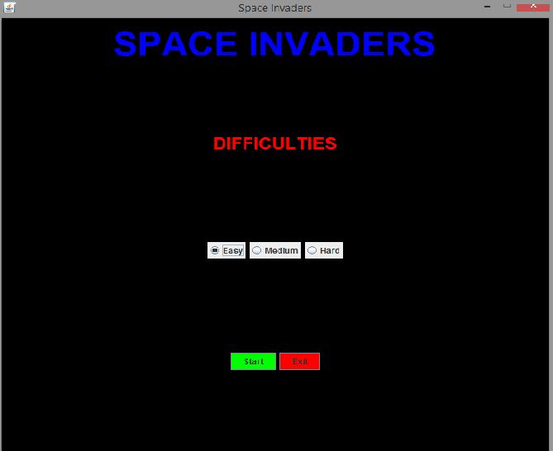
MAIN MENU

Slide 4
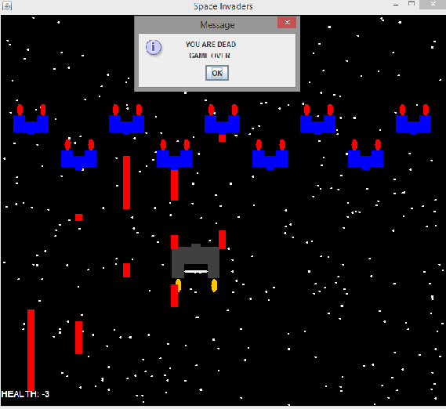
DEATH CASE

Slide 5
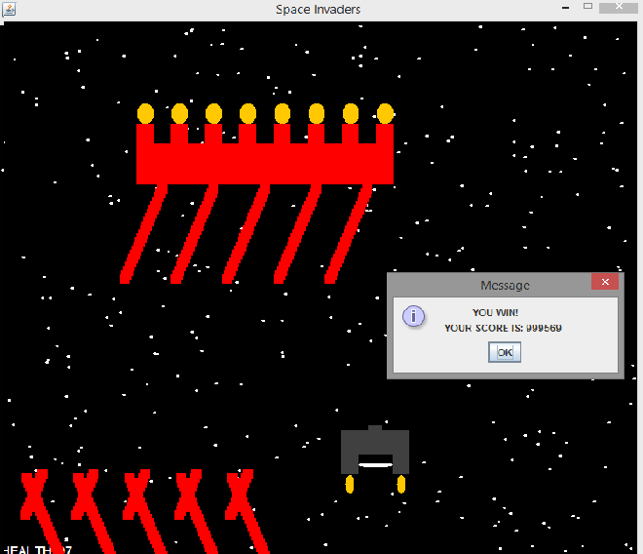
WIN CASE

Slide 6
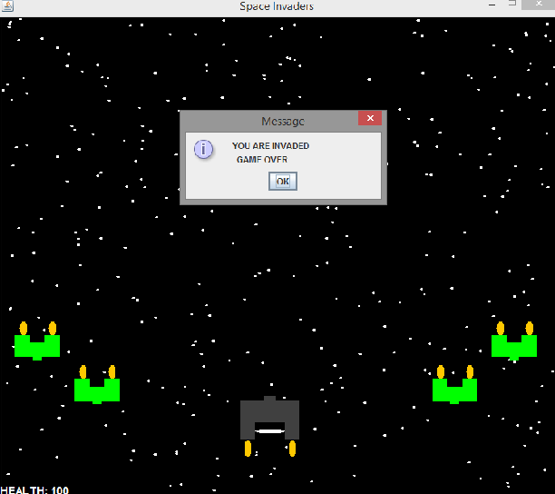
INVADED CASE

